Slide 1

Strategic Analysis of User Behavior & Transaction Value
By: Tri Umiati

Slide 2

Analysis Goals
Spot patterns in how users spend and interact
See which groups have the most potential to grow revenue
Share clear, data-based ideas to help us get more users, keep them longer, and reduce risk

Slide 3
How the Platform Is Performing
METRICS | VALUES | What It Tells Us
Total Spend | 876,1 M | Users are spending a lot → strong traction
Active Users | 231,7 K | Big user base → lots of room to grow
Avg. Spend/User | 359,6 K | High spend per user → great monetization potential

Slide 4

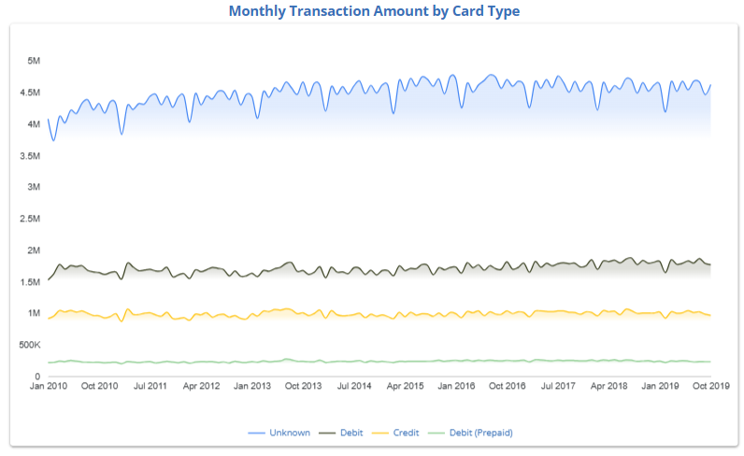
What Cards Users Prefer
Most users use Unknown Card Type → we should clean up this data
Debit Cards are steady → good for everyday users
Credit Cards are low → chance to promote with rewards or education
Prepaid Cards are small but promising → great for attracting new users

Slide 5

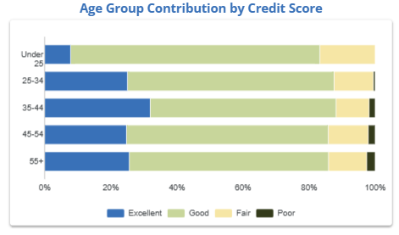
Credit Score by Age
Older users tend to have better credit scores, ideal for premium credit products and retention strategies.
Ages 25–44 are the sweet spot for credit-based products. This group have high earning and high adoption, should focus on cross sell and upsell.
Most of users under 25 often have Good credit scores. This group have great potential for entry level credit, education, and loyalty-building.

Slide 6
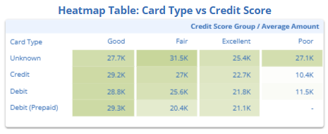
Who Spends the Most
Users with Good credit scores spend the most across all card types
Prepaid + Good Score → hidden gem segment
Poor scores → low spend, higher risk
Unknown Card Type shows high spend → needs better labeling

Slide 7
Behavior Matrix for Targeting
AGE GROUP | CREDIT SCORE | CARD TYPE | VALUE POTENTIAL | STRATEGY
< 25 | Fair / Good | Prepaid | Low | Onboarding education & starter packs
25 - 34 | Good / Excellent | Credit / Debit | High | Upsell, lifestyle bundling, loyalty program
35 - 44 | Good / Excellent | Credit / Debit | High | Cross sell, retention, premium upgrade
45 – 54 | Good / Excellent | Credit / Unknown | Stable | Premium product offers & trust based messaging
55 + | Good / Excellent | Credit / Unknown | Stable | Simplified UX, hybrid onboarding, premium retention

Slide 8

Recommendations
Focus on upselling Credit and Debit card users aged 25–44 with Good credit scores by offering cashback, lifestyle bundles, and optimizing the conversion funnel.
Activate younger Prepaid users under 25 by introducing starter credit products and running credit education campaigns to build long-term value.
Audit and reclassify Unknown card types among users aged 45+ to unlock hidden value and target them with premium retention offers.
Prioritize segments with Good credit scores across all age groups, as they consistently generate the highest transaction value.
Develop a segment filtered funnel dashboard with interactive controls for Age, Card Type, and Credit Score, including KPI labels and scenario toggles for stakeholder exploration.

Slide 9
THANK YOU!

